Slide 1
Basic Internship@Clevered AI App/ my chat bot v2.2.4
App User Manual
Author: Enoch

Slide 2
Table of Contents
Acknowledgements
About me
About the project
How to use the app

Slide 3
Acknowledgements
I thank cleveland for this internship and the opportunity to learn snap, i also thank my mentor for teaching me about snap and all its functions.

Slide 4

About Me..
Student’s Photograph
Hello my name is enoch, an 11 soon to be 12 year old boy, I Love To code stuff, and i'm going to show you all my latest project!

Slide 5
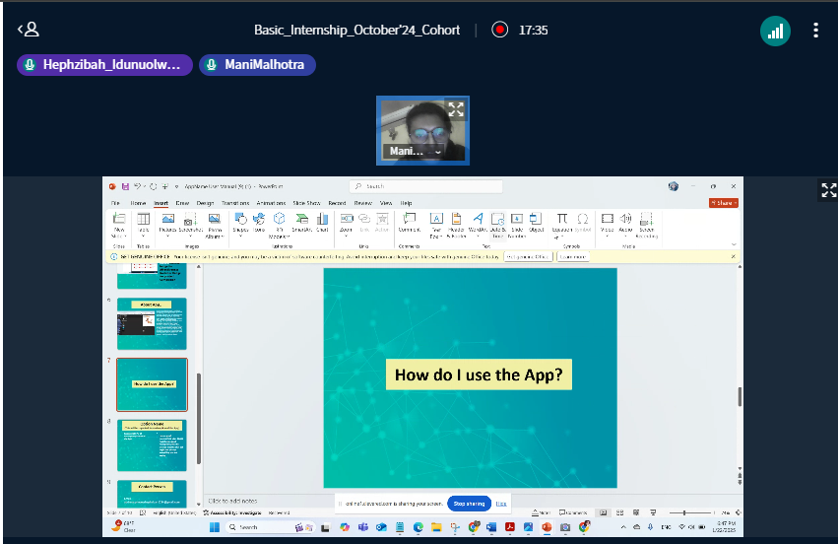
About My Internship with Clevered..
The Experience was good and we learnt new things and things about each other.
I have earned Rockstar Badge for project Completion 😎👍,and rockstar badge for Attentiveness 😎👍

Slide 6
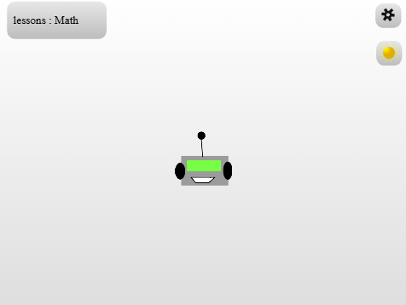
About App..
App’s Main Menu
My app is all about teaching people math (For now) and in general to offer a fun learning experience to the users

Slide 7
How do I use the App?
To start the project, click the green flag, then the bot will ask you if you want to learn a new thing or to practice, to learn something new press space, then it will ask you if you want integer operations or probability To choose between the options just speak out either Probability or integer operations then the bot will display formulas depending on what you’ve said
And to practice some algebra just click on the bot, and then it will ask your grade, but it will still ask you the same algebra question either way(for now) Then you have to solve for X in an algebra question, and you’re done!

Slide 8
Light and dark ui
Screenshot/ Pic of each option/screen of the App
Step 1 click on the green flag Step 2 : press enter to go into dark mode Step 3: press the up arrow key to switch to light mode Step 4 : enjoy!

Slide 9
Contact Person
My email: olayograce@gmail.com

Slide 10
Thank you!

